Slide 1

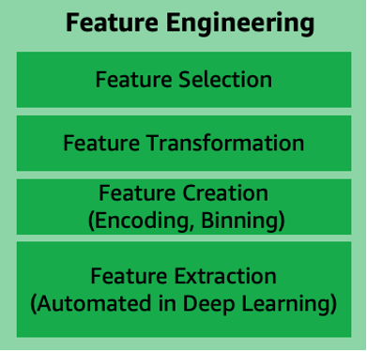
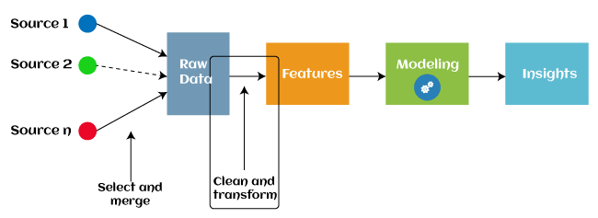
Feature Engineering
Definition: The process of creating new features from existing ones to enhance model performance.
Experimental Nature: It relies on the creativity of the programmer and is highly experimental.
Data Pre-processing
Definition: Transforming the dataset into a form suitable for model training.
Common Steps:
Scaling numeric variables

Slide 2
Encoding categorical variables
Key Libraries for Feature Engineering and Pre-processing:
Pandas Scikit-learn Tsfresh
Feature Engine NLTK
Handling Extreme Values
Questions to Ask:
Are the extreme values genuine?
Are the extreme values erroneous?
Identification Methods:
Mean and Standard Deviation IQR (Interquartile Range)
Percentiles (5th, 95th, etc.) Isolation Forest, Box Plot, KDE Plot
Remedial Steps:
Delete extreme values Cap/Floor values
Represent as missing for later imputation
Handling Missing Values
Questions to Ask:
Are values missing because they don’t exist? Were they not recorded?
Remedial Steps:
Delete missing values
Impute using Mean, Median, Mode, Constant, or algorithms like MICE, KNN
Mathematical Operations
Combining Features:
Aggregations: Sum, Max, Min, Mean Relativity: Ratios, Differences
Transformations:

Slide 3
Log, Square Root, Reciprocal, Exponential
Power Transformations (Box-Cox, Yeo-Johnson)
Feature Discretization:
Equal Width, Equal Frequency, Arbitrary Intervals, K-Means Clustering
Feature Scaling
Techniques:
Standardization Normalization
Median and IQR Scaling
Handling Categorical Variables
Steps:
Encoding:
Ordinal Encoding One-Hot Encoding
Rare-label Encoding
Frequency Encoding Target Mean Encoding
Manipulation:
Group rare categories
Convert to meaningful values or binary categories
Handling Date and Time Variables
Feature Extraction:
Day, Month, Year, Quarter, Weekday Hour, Minute, Second
New Features:
Time lag, Differences between two dates
Handling Text Variables
Feature Extraction:
Frequency of characters, words, and unique words
Ratios:
Take ratios based on the extracted features

Slide 4
Feature Selection
Filter Methods:
Ranking variables based on statistical metrics like Chi-square, F-test, Correlation, Mutual Information.
Wrapper Methods:
Generate subsets of features and train models on each subset. Techniques include: Exhaustive Search
Forward Elimination
Backward Elimination
Embedded Methods:
Use models like Linear Regression, LASSO, Decision Trees, and Random Forest to select features based on their coefficients or feature importance.
Key Components in Feature Engineering
Built-in Transformers:
Python Class, Python Function, Function Transformer
Pipeline and Feature Union: Combine various transformations into a cohesive process.
General Sequence of Steps for Data Preprocessing:
Import Libraries: Pandas, Scikit-learn, etc.
Display Settings: Adjust pandas display options and ignore warnings.
Read Training Data.
Transformation Operations (e.g., for specific columns like 'Airline', 'Date of Journey', etc.).
Feature Selection: Based on individual feature performance.
Final Data Preprocessing and Model Training.
Feature Engineering and Data Preprocessing
1. Import Libraries
import pandas as pd import numpy as np
from sklearn.preprocessing import StandardScaler, OneHotEncoder, PowerTransforme from sklearn.impute import SimpleImputer
from sklearn.feature_selection import SelectKBest, chi2, mutual_info_classif

Slide 5
from sklearn.model_selection import train_test_split
from sklearn.ensemble import IsolationForest import matplotlib.pyplot as plt
import seaborn as sns
2. Data Overview & Display Settings
pd.set_option('display.max_columns', None) pd.set_option('display.max_rows', None)
3.
Rea
ding Data
# Load your dataset here
df = pd.read_csv('your_dataset.csv') df.head()
Identifying and Handling Extreme Values
4. Identify Extreme Values
Using mean, standard deviation, IQR, and plots:
def identify_extreme_values(df, column): mean = df[column].mean()
std_dev = df[column].std()
iqr = df[column].quantile(0.75) - df[column].quantile(0.25) lower_bound = df[column].quantile(0.25) - 1.5 * iqr upper_bound = df[column].quantile(0.75) + 1.5 * iqr print(f'Mean: {mean}, Std Dev: {std_dev}, IQR: {iqr}') return lower_bound, upper_bound
lower, upper = identify_extreme_values(df, 'column_name')
5. Remedial Steps for Extreme Values
Capping extreme values:
df['column_name'] = np.where(df['column_name'] > upper, upper, df['column_n df['column_name'] = np.where(df['column_name'] < lower, lower, df['column_n

Slide 6
Visualization of Extreme Values
sns.boxplot(df['column_name']) plt.show()
Handling Missing Values
Imputation of Missing Values
imputer = SimpleImputer(strategy='mean')
df['numeric_column'] = imputer.fit_transform(df[['numeric_column']])
Creating Indicator Columns for Missing Values
df['missing_numeric_column'] = df['numeric_column'].isna().astype(int)
Feature Engineering
Mathematical Operations on Features
df['new_feature'] = df['feature1'] + df['feature2'] # Example: Sum df['log_feature'] = np.log1p(df['numeric_column']) # Example: Logarithmic Tran
Polynomial Features
from sklearn.preprocessing import PolynomialFeatures
poly = PolynomialFeatures(degree=2, interaction_only=True) poly_features = poly.fit_transform(df[['feature1', 'feature2']])
Feature Scaling
Feature Scaling
scaler = StandardScaler()
df[['numeric_column']] = scaler.fit_transform(df[['numeric_column']])
Encoding Categorical Variables
One-Hot Encoding

Slide 7
ohe = OneHotEncoder()
encoded_cols = ohe.fit_transform(df[['categorical_column']]).toarray()
13. Rare-Label Encoding
freq_counts = df['categorical_column'].value_counts() rare_labels = freq_counts[freq_counts < threshold].index
df['categorical_column'] = df['categorical_column'].replace(rare_labels, 'Rare')
Date and Time Feature Engineering
Extracting Date Features
df['day'] = pd.to_datetime(df['date_column']).dt.day df['month'] = pd.to_datetime(df['date_column']).dt.month
Text Feature Engineering
Text Frequency Features
df['word_count'] = df['text_column'].apply(lambda x: len(str(x).split()))
Feature Selection
Filter Method: Chi-Square Test
X = df[['feature1', 'feature2']] y = df['target']
chi2_selector = SelectKBest(chi2, k=5) X_new = chi2_selector.fit_transform(X, y)
Wrapper Method: Recursive Feature Elimination
from sklearn.feature_selection import RFE
from sklearn.linear_model import LogisticRegression
model = LogisticRegression() rfe = RFE(model, 5)
fit = rfe.fit(X, y)

Slide 8
Putting It All Together
18. Data Preprocessing Pipeline
from sklearn.compose import ColumnTransformer from sklearn.pipeline import Pipeline
from sklearn.preprocessing import StandardScaler, OneHotEncoder
numeric_features = ['feature1', 'feature2'] categorical_features = ['category1', 'category2']
numeric_transformer = Pipeline(steps=[ ('scaler', StandardScaler())])
categorical_transformer = Pipeline(steps=[
('onehot', OneHotEncoder(handle_unknown='ignore'))])
preprocessor = ColumnTransformer( transformers=[
('num', numeric_transformer, numeric_features),
('cat', categorical_transformer, categorical_features)])
clf = Pipeline(steps=[('preprocessor', preprocessor),
('classifier', LogisticRegression())])
clf.fit(X_train, y_train)
This notebook structure will help guide the entire data preprocessing and feature engineering workflow. You can adjust specific functions and techniques based on your dataset's
requirements.

